Slide 1

Vehicle Counting and Detection for parking area
Project Supervisor:
Dr. Satya Bhushan Verma
(HoD, DCSE)
Under the guidance of:
Mr. Neelesh Mishra
(Assistant professor)

Slide 2
Group members:
Neeraj Tiwari - 201910101110021
Abhishek Pratap Singh - 201910101110006
Md. Armaan - 201910101110050
Anurag Jain - 201910101110052

Slide 3
OBJECTIVE OF Vehicle Counting and Detection for parking area
A GUI with Login page.
Detect vehicles entering and leaving the campus parking area.
Counting of vehicles entering and leaving campus parking area with parking limit .
Classification of vehicles based on its types
Easy access of data by campus authorities through csv for efficient monitoring.

Slide 4
Need ?
There was a need of software that provides data about the total count of vehicles entering and leaving the campus parking area and detect the type of vehicle and provide their count for which there was not any system specially designed for university campus .
To fulfill this need we developed a detection and counting algorithm specifically for the institutions to analyze the type of vehicle and counting the vehicles incoming and outgoing from the university campus help to organize the crowd in campus, and this will reduce the work of university guards.

Slide 5
Functions:
Login page.
Algorithm Launch page
Vehicle counting and detection.
Output page.
Data saved at csv file.

Slide 6
Block diagram for object detection and tracking:
User Login
Algorithm launch
Real time/video dataset as Input
Pre -processing
Training network and algorithms
Vehicle detection
Vehicle counting
Output

Slide 7
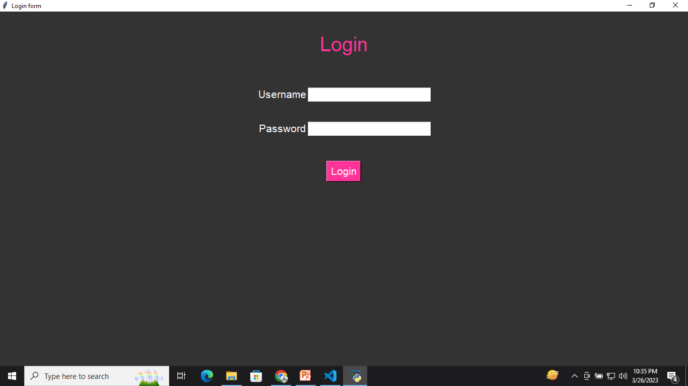
home Page
The login page is made by tkinter library of the python, which is used to develop GUI.

Slide 8
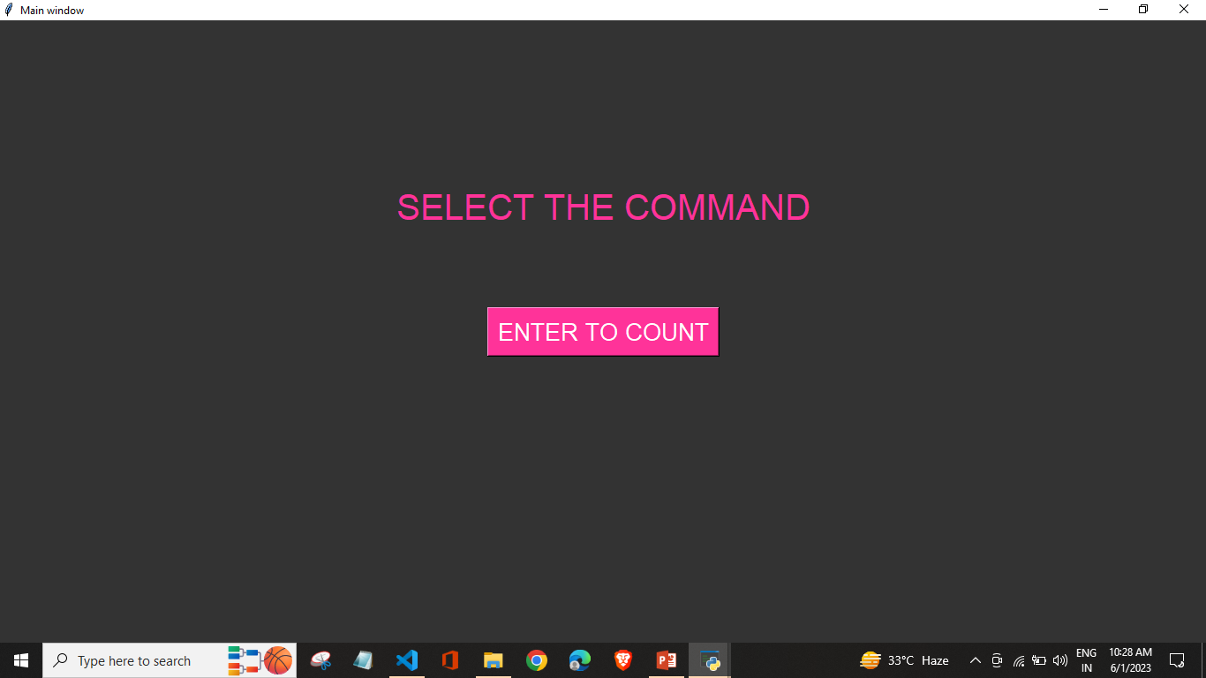
Video path

Slide 9
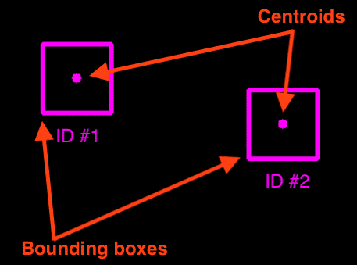
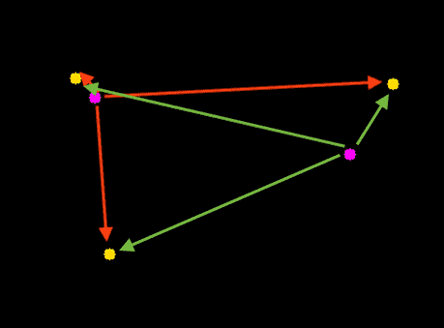
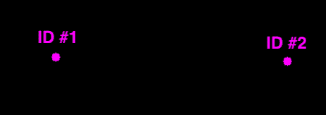
Counting algorithm
The tracker basically uses the Euclidean distance concept to keep track of an object. It calculates the difference between two center points of an object in the current frame vs. the previous frame, and if the distance is less than the threshold distance then it confirms that the object is the same object of the previous frame.

Slide 10
Detection:
For detection we have used YOLO which is a pre-trained model.
It works with external weights and their configuration file, which has pre trained dataset, which works when particular data is called.
YOLO is used because it is fast and easy to use and reduces, the work and time spend on training each dataset separately.

Slide 11
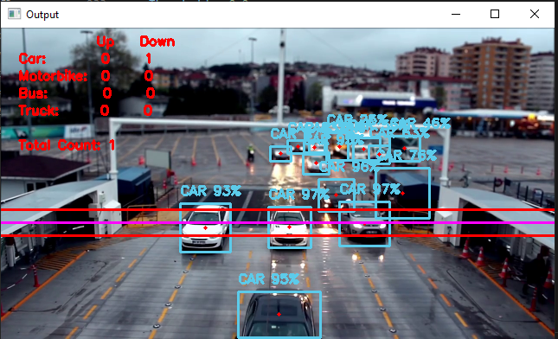
OUTPUT

Slide 12
